Slide 1
AI Based Electricity Monitoring System
Project Title: AI Based Electricity Monitoring System
Branch: IT
Group Leader: Reeta Koranga (0818IT221055)
Member 1: Prince Rai (0818IT221049)
Member 2: Chandan Patidar (0818IT221019)
Member 3: Aashi Pandey (0818IT221003)

Slide 2
AI Based Electricity Monitoring System
Introduction
Introduction to energy consumption challenges.
Growing demand for smart energy solutions.
Brief overview of AI's potential in energy management.
Objectives of the project: real-time monitoring, prediction, and suggestion for savings.

Slide 3
AI Based Electricity Monitoring System
Problem Statement
Traditional energy systems lack intelligence.
Users unaware of high consumption points.
Wastage due to inefficient use of appliances.
No personalized insights for energy saving.

Slide 4
AI Based Electricity Monitoring System
Appliance-wise breakdown.
Web-based interface for user interaction.
Real-time and historical analysis.
Proposed Solution
Monitor appliance-level energy data.
Predict future usage based on historical patterns.
Suggest optimizations using AI algorithms.
Help users reduce bills and carbon footprint.

Slide 5
AI Based Electricity Monitoring System
Existing System vs Proposed System
Feature | Existing Systems | Proposed System
Real-time Monitoring | Limited | Yes
AI Predictions | No | Yes
Appliance-level Data | Partially | Fully Integrated
Suggestions | Generic | Personalized via AI

Slide 6
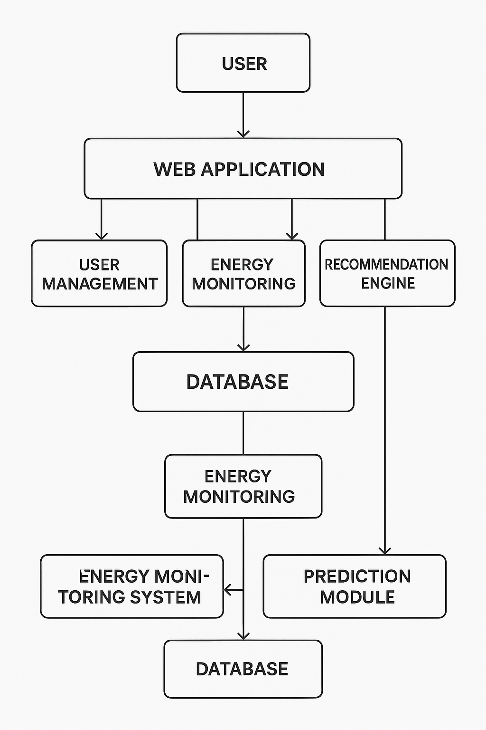
AI Based Electricity Monitoring System
Methodology
Data collection from sensors.
Processing using AI algorithms.
Frontend: Web dashboard.
Backend: Django.
Visualization tools for insights.

Slide 7
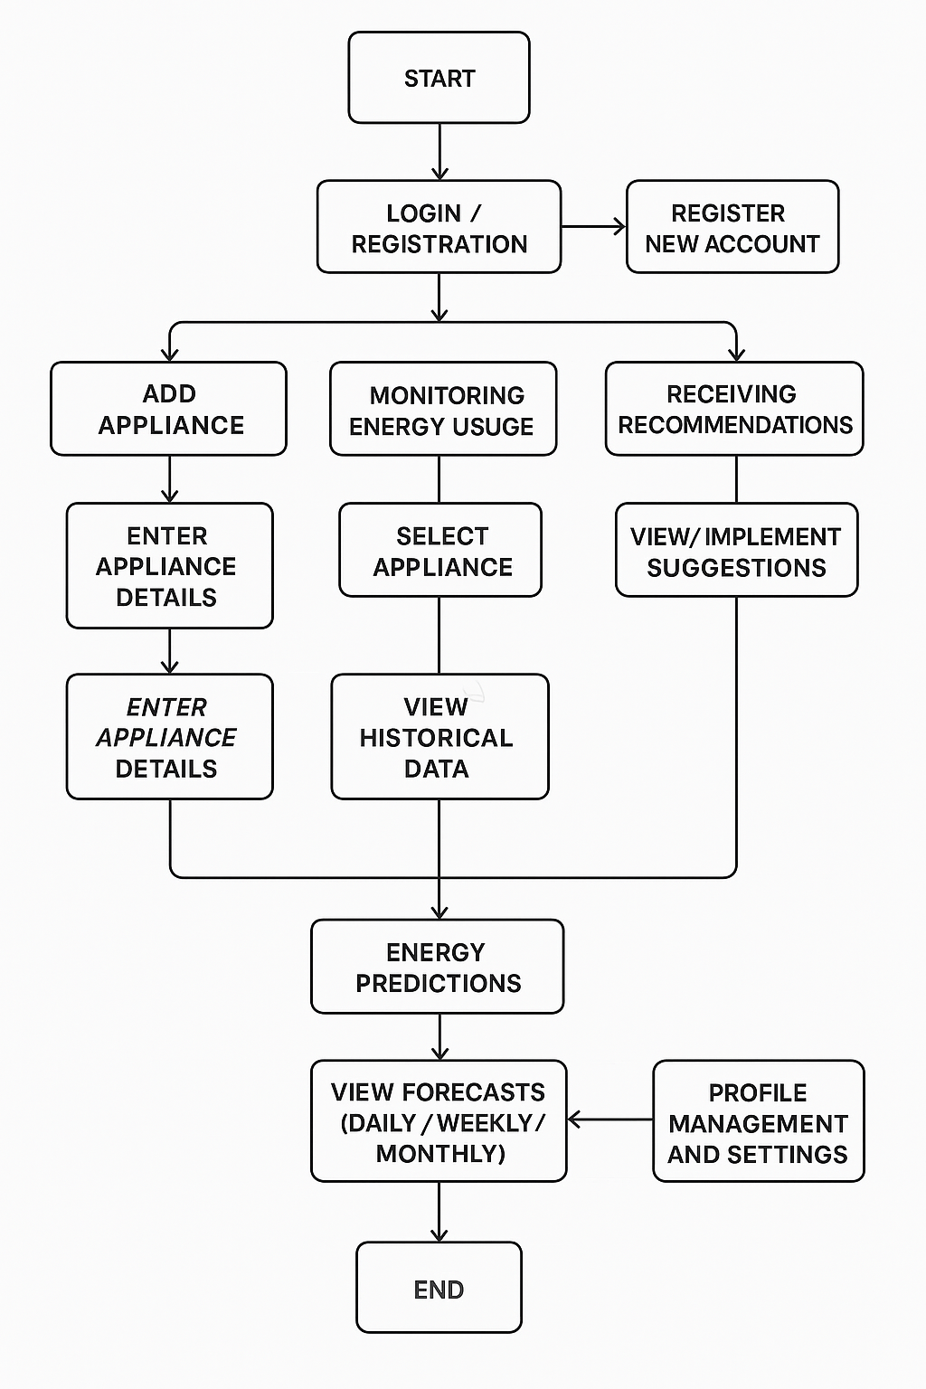
AI Based Electricity Monitoring System
Testing and Validation
Unit testing: Modules
Integration testing: Backend + Frontend
System testing: Overall workflow
Results: Accuracy of predictions, usability feedback

Slide 8
References
Energy Reports, IEEE Papers
AI in Smart Homes, Elsevier
Django & Machine Learning Tutorials
Appliance Load Datasets

Slide 9
AI Based Electricity Monitoring System
Conclusion and Future Work
Summary of benefits
Real-time tracking, AI forecasting, reduced wastage
Future: IoT integration, mobile app, solar compatibility

